Slide 1
Conference Room Booking System

Slide 2
Scope
This is the web based application which will allow a user to book a conference room of a hotel by choosing different options according to their needs. This will give a common platform to view and book conference rooms.
In this pandemic situation, it is beneficial for both customers and owners, as a user can book a conference room according to his requirements from anywhere skipping the long waiting time in the hotel lobby and as an added bonus it helps for promotion for hotels.

Slide 3
Modules
Authentication
Searching
Booking
Feedback

Slide 4
Development Tools Details
Tools | Use
Spring tool suite 4 | Back End
React | Front End
MySql | Database
Git | Version control

Slide 5
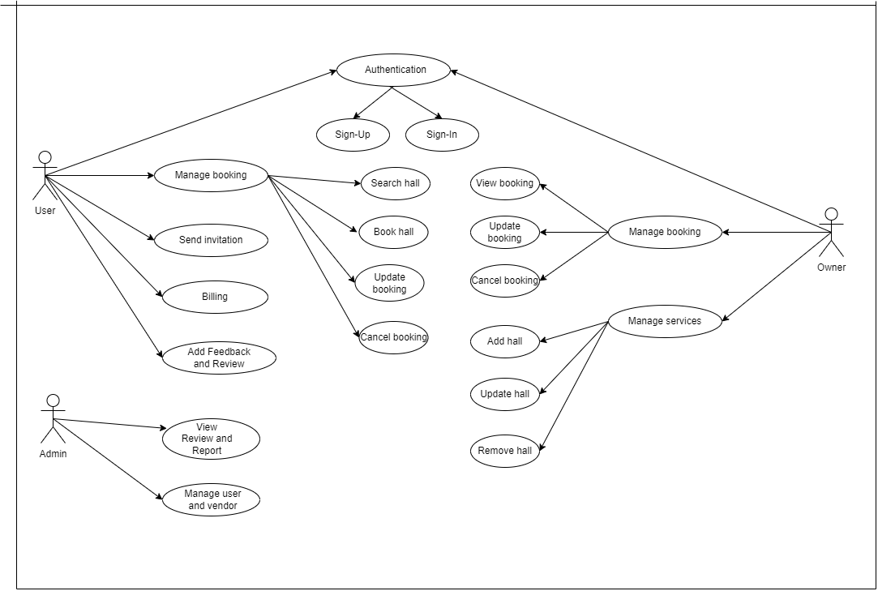
Usecase Diagram

Slide 6
Thank You

